Slide 1


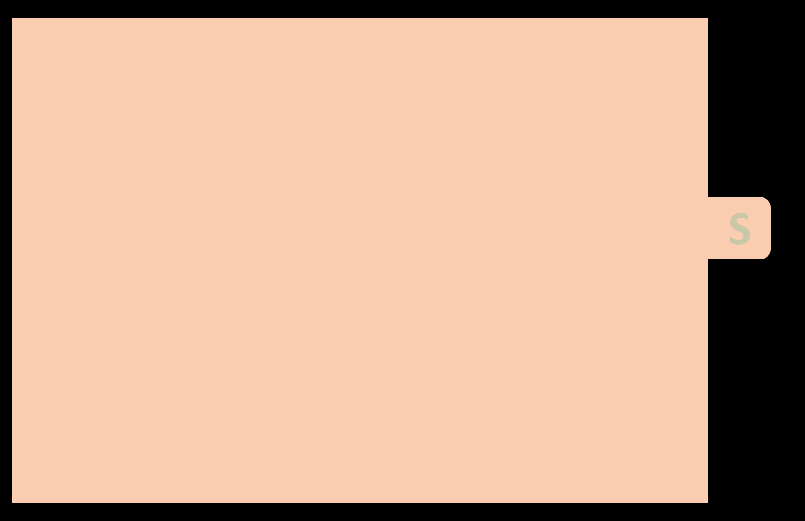
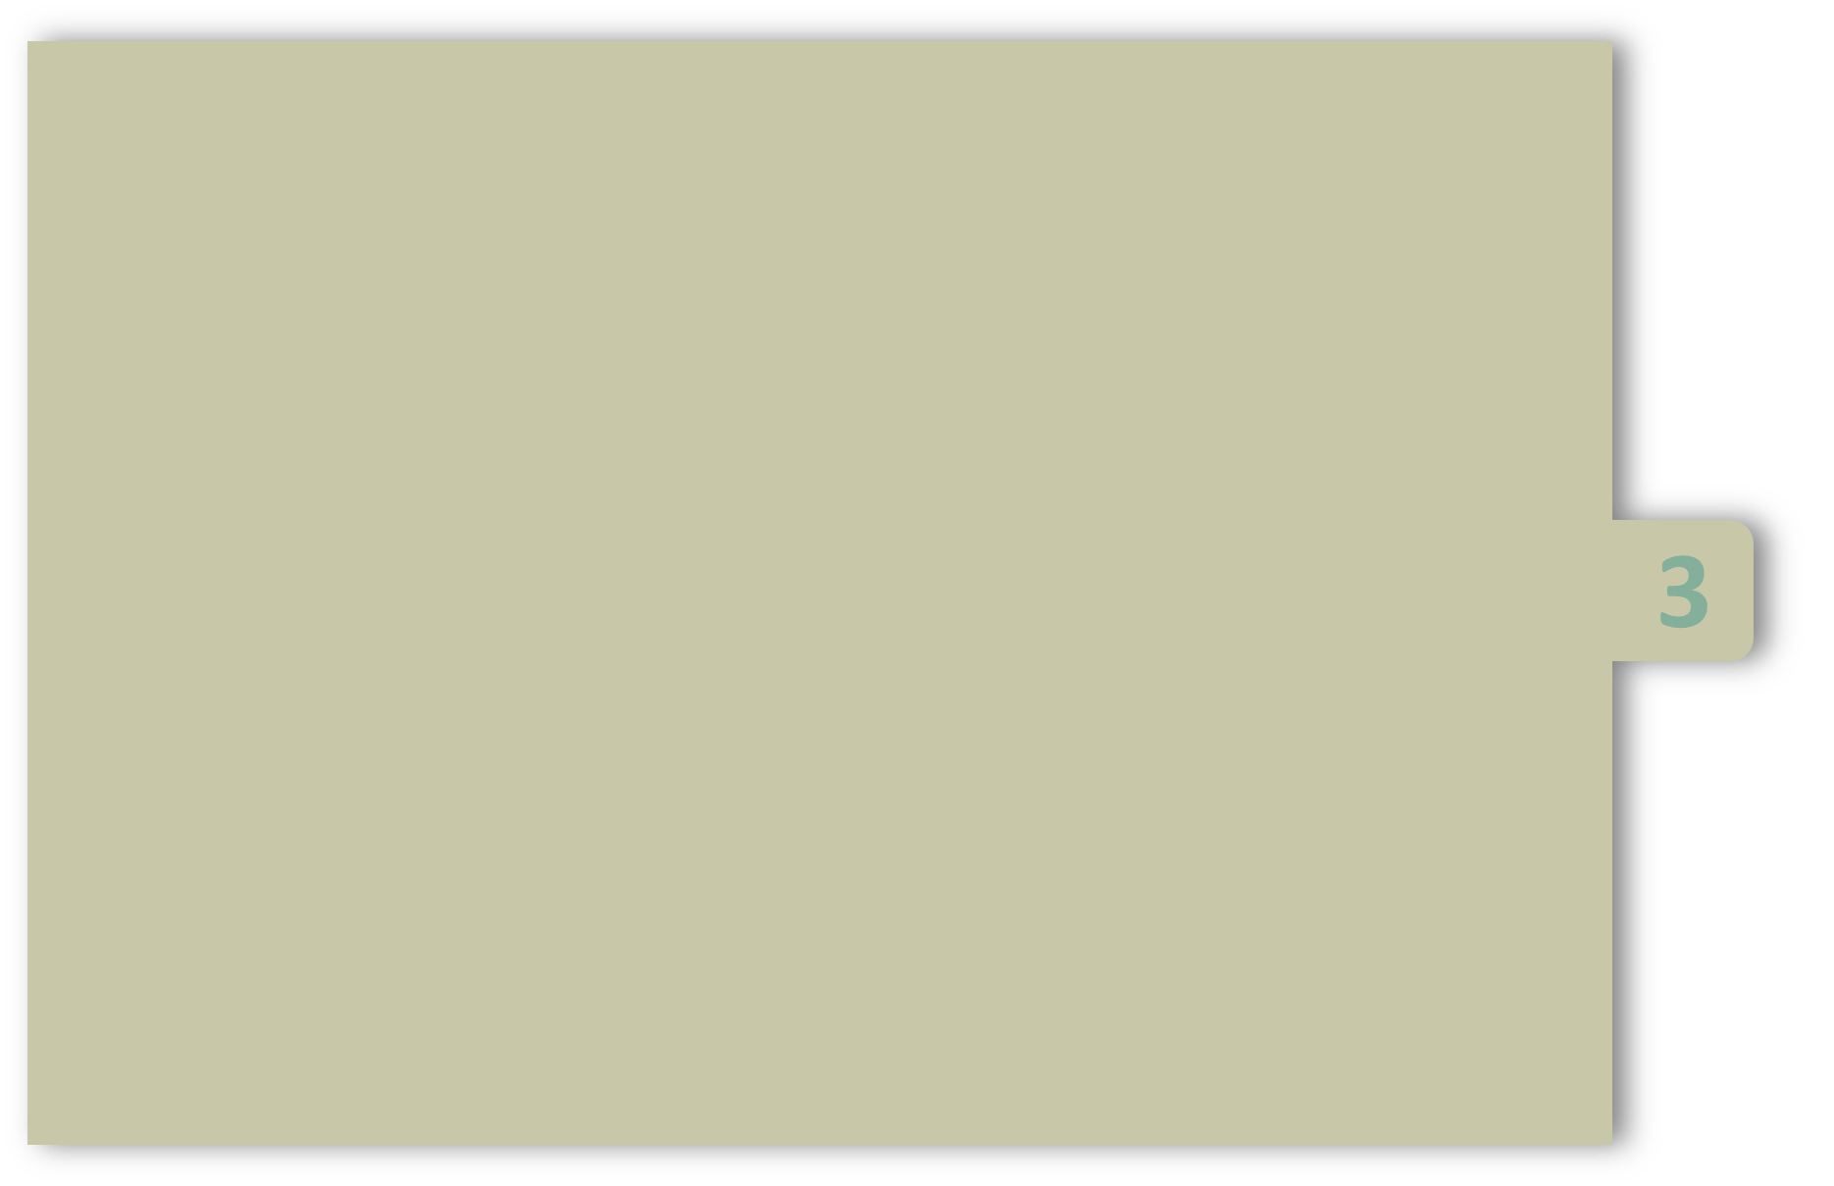
UNIT-III
Arrays:
    Definition,
    Types: 1D, Multi Dimensional arrays,
    declaration, initialization, accessing elements,
    Matrix operations
    String Handling.
Pointers:
    Definition
    Declaration, Initialization
    Pointer arithmetic
    Pointer to pointer
    arrays and pointers
    Dynamic memory allocation

Slide 2
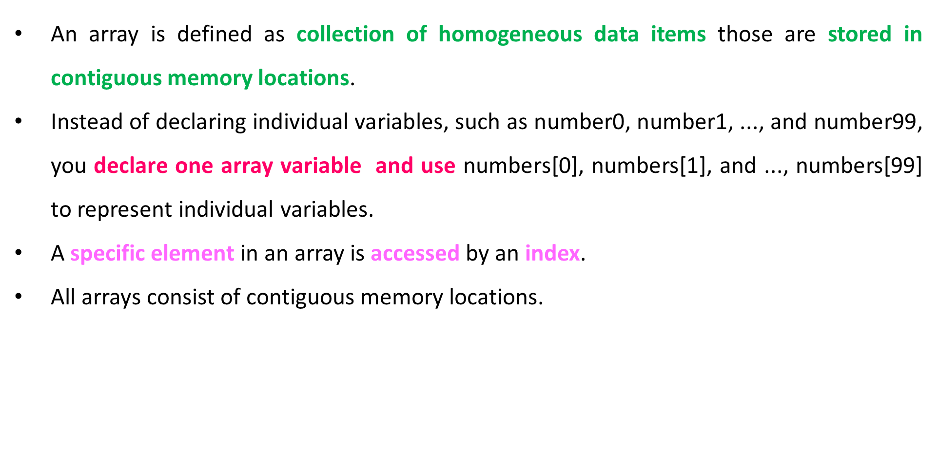
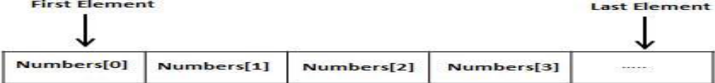
Definition

Slide 3
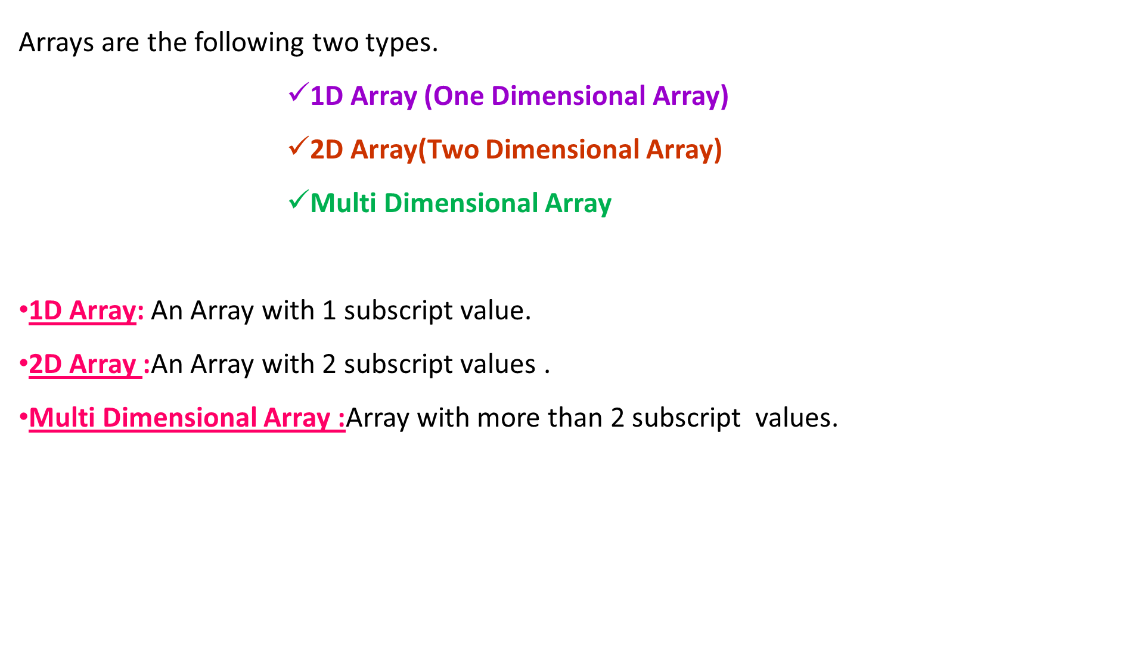
Types of Array

Slide 4
Declaration of 1D Array
To declare an array in C, a programmer specifies the type of the elements and the number of elements required by an array .
The arraySize must be an integer constant greater than zero and type can be any data type.
Now, sohel is array variable which holds up-to 10 integer numbers.
Syntax
data type arrayname [Size ];
Example
int sohel [10];

Slide 5
Initializing 1D-Arrays
You can initialize array in C by using 2 methods:
Static
Dynamic
1)static: You can initialize array either one by one or using a single statement as follows:
Syntax
datatype arrayname [Size ] = {List of elements};
Example
int a[4]={10,20,30,40};

Slide 6
1.Static Initializing 1D-Arrays
The number of values between braces { } cannot be larger than the size that we declare for the array between square brackets [ ].
You can initialize array elements one by one as follows:
Example:
a[0]={10}
a[1]={20}
a[2]={30}
a[3]={40}

Slide 7
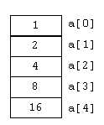

1.Static Initializing 1D-Arrays
If you omit the size of the array.
int a[ ] = {1,2,4,8,16};
All arrays have 0 as the index of their first element which is also called base index.
Following is the pictorial representation of the same array (contiguous memory locations)

Slide 8
2.Dynamic Initializing 1D-Arrays
Syntax
for(i=0;i<size;i++)
{
Scanf(“format specifier”, & arrayname [i] )
}
Example
For(i=0;i<5;i++)
{
Scanf(“%i”, & sohel [i] )
}
Example
int sohel [5];

Slide 9
How to initialize?
Way 1 | Way2
int a[5] = {2,4,6,8,5}; a[0]=2; a[1]= 4; a[2]=6; a[3]=8; a[4] = 5; | int a[ ] = { 2,4,6,8,5}; a[0]=2; a[1]= 4; a[2]=6; a[3]=8; a[4] = 5;
Way 3 | Way4
int a[5]; a[0]=2; a[1]= 4; a[2]=6; a[3]=8; a[4] = 5; | int a[5]; for(int i=0; i<5; i++) scanf(“%d”, &a[i]);

Slide 10
Accessing 1D-Array Elements
An element is accessed by index of the array .
This is done by placing the index of the element within square brackets after the name of the array.
The above statement will take 5th element from the array and assign the value to b.
Example
int b = a[4];

Slide 11
#include <stdio.h> int main () { int hemanth[ 5 ]; /* hemanth is an array of 5 integers */ int i, j; printf (“\n Enter 5 values”); for ( i = 0; i < 5; i++ ) { scanf(" %i ", &hemanth[i] ); /* initialize elements */ } for (j = 0; j < 5; j++ ) { printf("Element[%d] = %d\n", j, hemanth[j] ); /* accessing each array element */ } } | Output: Enter 5 values 10 11 12 13 14 Element[0] = 10 Element[1] = 11 Element[2] = 12 Element[3] = 13 Element[4] = 14

Slide 12
2D Array
The simplest form of the multidimensional array is the two-dimensional array.
A two-dimensional array is a list of one-dimensional arrays.
A two-dimensional array can be like as a table which will have x number of rows and y number of columns.
To declare 2D-array in C, a programmer specifies the type of the elements and the number of rows and columns required by an array .
Syntax
Data type array name [row size ][col size];

Slide 13

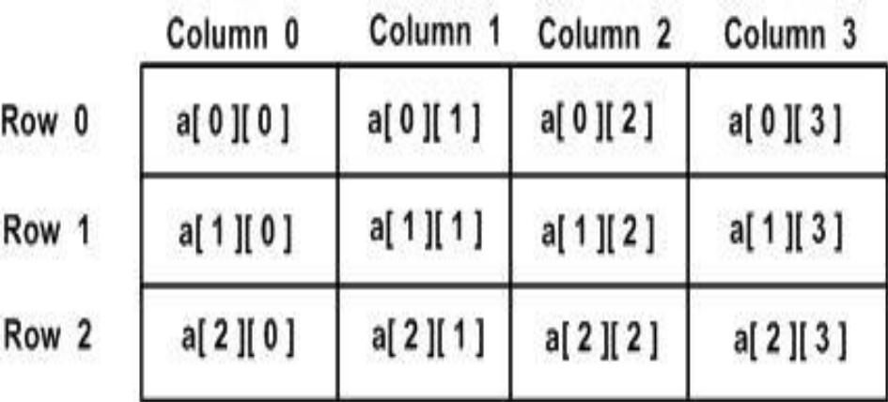
Declaring 2D Array
A 2D- array , which contains three rows and four columns can be shown as below:
Now sohel is array variable which holds up-to 12 ( 3x4=12) integer numbers.
Example
int sohel[3][4];
Thus, every element in array is identified by an element name of the form sohel[ i ][ j ].
where a is the name of the array, and i and j are uniquely identify each element .

Slide 14
Initializing 2D-Arrays
You can initialize array in C by using 2 methods:
static 2)dynamic
1)static: You can initialize array in C either one by one or using a single statement as follows:
Way-I:
Syntax
Datatype arrayname [row Size ][col size] = {List of elements};
Example
int a[3][3]={10,20,30,40};

Slide 15
Initializing 2D-Arrays
Multidimensional arrays may be initialized by specifying bracketed values for each row.
Following is an array with 3 rows and each row has 4 columns.
Way 2: int a[3][4] = { {0, 1, 2, 3} , {4, 5, 6, 7} , {8, 9, 10, 11} };
2)Dynamic:
for(int i=0 ; i<row size ; i++)
{
for(int j=0; j<col size; j++)
{
scanf(“format Specifier” , &array name [i][j] );
}
}
for(int i=0; i<3; i++)
{
for(int j=0; j<4; j++)
{
scanf(“%d”,&a[i][j]);
}
}

Slide 16
Accessing Two-Dimensional Array Elements
An element in 2-dimensional array is accessed by using the subscripts, i.e., row index and column index of the array.
Let us check below program where we have used nested loop to handle a two dimensional array:

Slide 17
Accessing Two-Dimensional Array Elements
#include <stdio.h> int main () { int a[5][2] = { {0,0}, {1,2}, {2,4}, {3,6},{4,8}}; int i, j; for ( i = 0; i < 5; i++ ) { for ( j = 0; j < 2; j++ ) { printf(“\n a[%i][%i] = %i ", i , j, a[i][j] ); } } return 0; } | Output: a[0][0]: 0 a[0][1]: 0 a[1][0]: 1 a[1][1]: 2 a[2][0]: 2 a[2][1]: 4 a[3][0]: 3 a[3][1]: 6 a[4][0]: 4 a[4][1]: 8

Slide 18
Program to Add Two Matrices
#include <stdio.h> int main( ) { int r, c, a[10][10], b[10][10], sum[10][10], i, j; printf("Enter the number of rows: "); scanf("%d", &r); printf("Enter the number of columns: "); scanf("%d", &c); printf("\nEnter elements of 1st matrix:\n"); for (i = 0; i < r; i++) { for (j = 0; j < c; j++) { scanf("%d", &a[i][j]); } } | printf("Enter elements of 2nd matrix:\n"); for (i = 0; i < r; i++) { for (j = 0; j < c; j++) { scanf("%d", &b[i][j]); } } // adding two matrices for (i = 0; i < r; ++i) { for (j = 0; j < c; ++j) { sum[i][j] = a[i][j] + b[i][j]; } }

Slide 19
Program to Add Two Matrices
// printing the result printf("\nSum of two matrices: \n"); for (i = 0; i < r; i++) { for (j = 0; j < c; j++) { printf("%3i", sum[i][j]); } printf("\n"); } } | Output: Enter the number of rows: 2 Enter the number of columns: 3 Enter elements of 1st matrix: 2 3 4 5 2 3 Enter elements of 2nd matrix: -4 5 3 5 6 3 Sum of two matrices: -2 8 7 10 8 6

Slide 20
Program to Multiply Two Matrices
int main() { int a[10][10],b[10][10],c[10][10],r,c,i,j,k; printf(“\n enter the r1 and c1 values "); scanf("%i %i",&r1,&c1); printf(“\n enter the r2 and c2 values"); scanf("%i %i",&r2,&c2); if(c1!=r2) { printf(“Multiplication not possible”); break; } else { printf("enter the first matrix element="); for(i=0;i<r1;i++) for(j=0;j<c1;j++) scanf("%i",&a[i][j]); | printf("enter the second matrix element="); for(i=0;i<r2;i++) for(j=0;j<c2;j++) scanf("%i",&b[i][j]); printf("multiply of the matrix=\n"); for(i=0;i<r1;i++) for(j=0;j<c2;j++) { mul[i][j]=0; for(k=0;k<r2;k++) { c[i][j]+=a[i][k]*b[k][j]; } }

Slide 21
Program to Multiply Two Matrices
//for printing result for(i=0;i<r1;i++) { for(j=0;j<c2;j++) { printf("%3d",c[i][j]); } printf("\n"); } return 0; } | Output: enter the r1 and c1 values 3 3 enter the r2 and c2 values 3 3 enter the first matrix element= 1 1 1 2 2 2 3 3 3 enter the second matrix element= 1 1 1 2 2 2 3 3 3 multiply of the matrix= 6 6 6 12 12 12 18 18 18

Slide 22

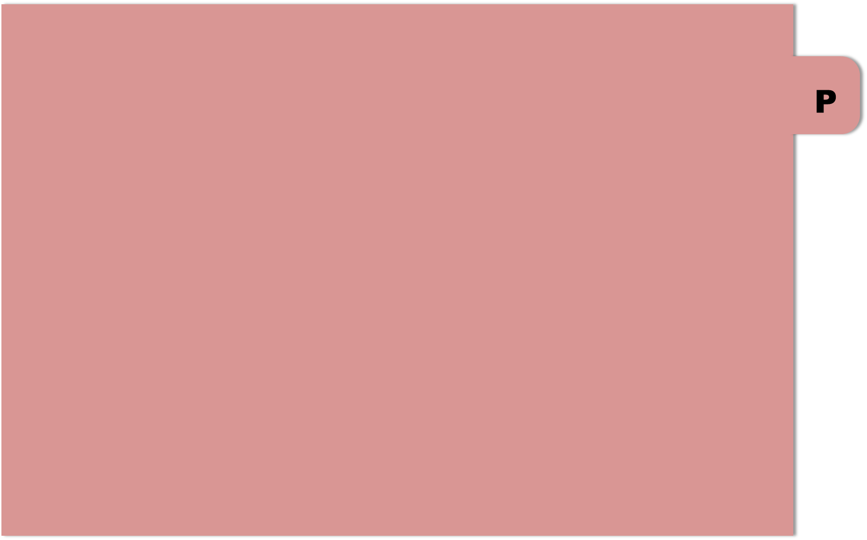

THANK YOU

